Slide 1

IMAGE STYLE TRANSFER
LE CHI ANH - 20224296
NGUYEN TRONG NGHIA - 20224274

Slide 2
TABLE OF CONTENTS
Introduction
Methods
Experiments
Results
References

Slide 3


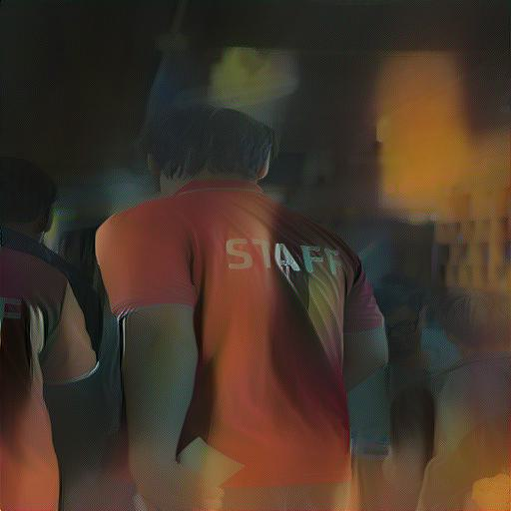
1.Introduction
+
=
Content image
Style image
Output image

Slide 4
2. Methods
VGG-19
CNN
Image to fixed resolution: 512x512
Extracted feature: Content feature, Style feature
Loss

Slide 5
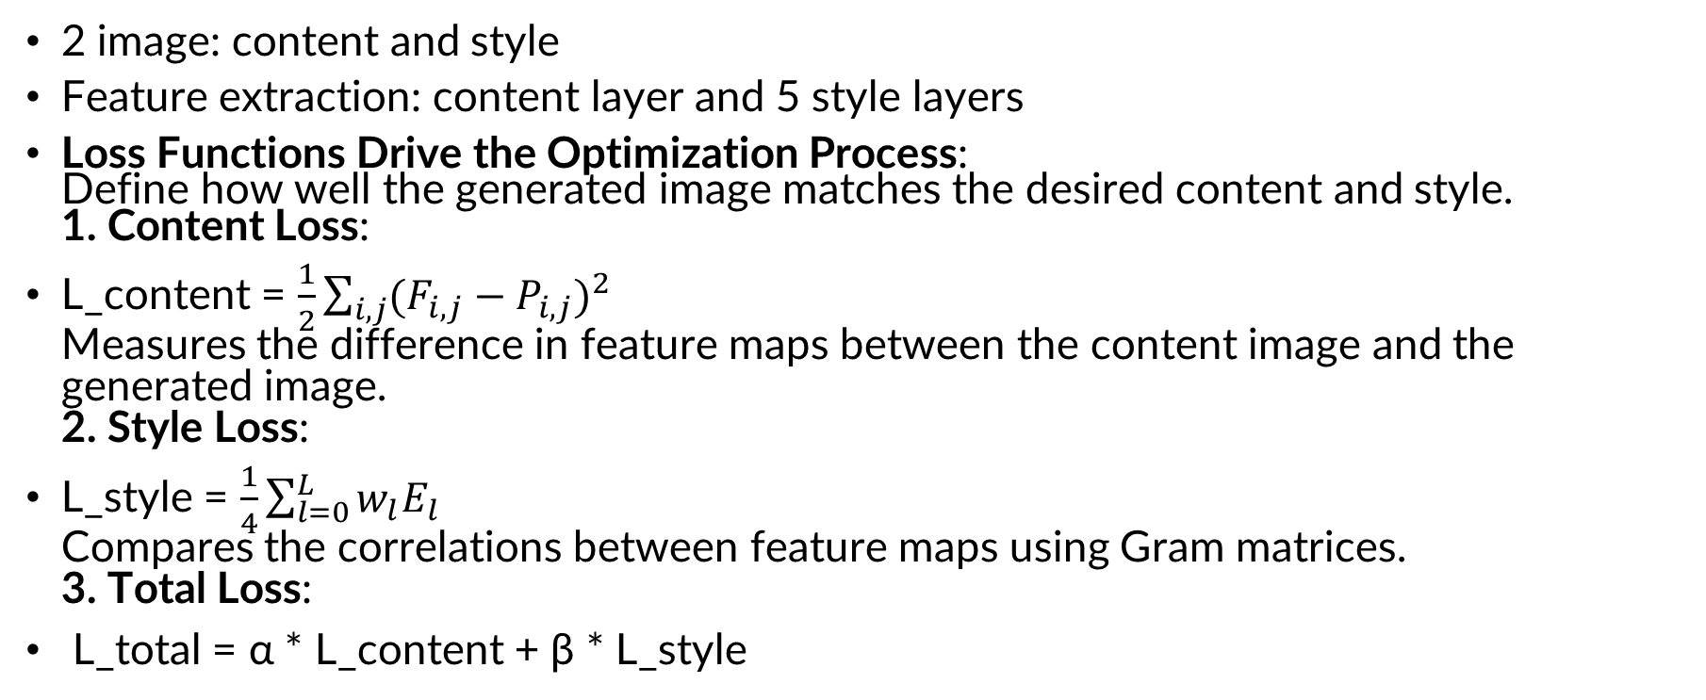
3.Experiments
2 image: content and style
Feature extraction: content layer and 5 style layers
Loss Functions Drive the Optimization Process: Define how well the generated image matches the desired content and style. 1. Content Loss:
L_content = $\frac{1}{2}\sum_{i,j}{{{(F}_{i,j} − P_{i,j})}^{2}}$ Measures the difference in feature maps between the content image and the generated image. 2. Style Loss:
L_style = $\frac{1}{4}\sum_{l=0}^{L}{w_{l}E_{l}}$ Compares the correlations between feature maps using Gram matrices. 3. Total Loss:
L_total = α * L_content + β * L_style
The loss function from: https://www.cvfoundation.org/openaccess/content_cvpr_2016/papers/Gatys_Image_Style_Transfer_CVPR_2016_paper.pdf

Slide 6
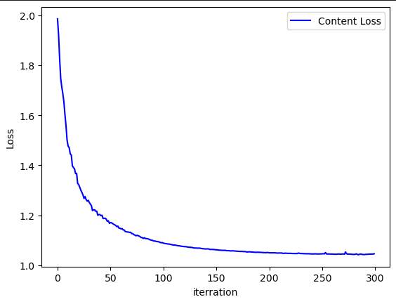
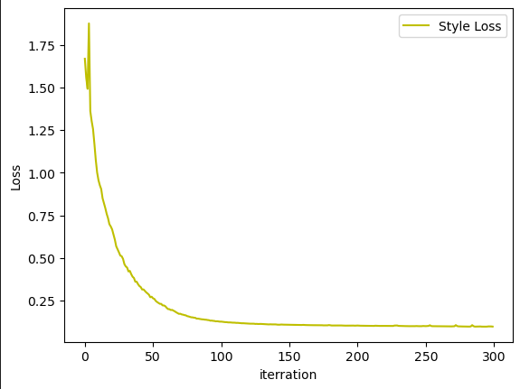
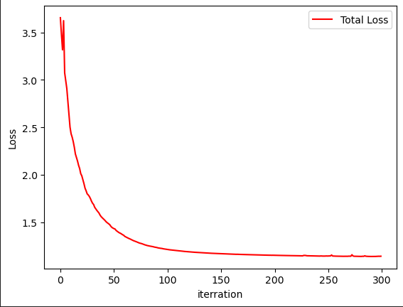
4. Result
Content loss
Style loss
Total loss

Slide 7
4.Result
+
=
Content image
Style image
Output image

Slide 8
5. Reference
Image Style Transfer Using Convolutional Neural Networks: cv-foundation.org/openaccess/content_cvpr_2016/papers/Gatys_Image_Style_Transfer_CVPR_2016_paper.pdf
GitHub code:
https://github.com/Aleadinglight/Pytorch-VGG-19/blob/master/VGG_19.ipynb

Slide 9
THANK YOU !

